Slide 1
Debbie Sorensen, Ph.D.
Denver V.A. Medical Center debbie.sorensen@gmail.com
Panel: Utilizing ACT to Understand and Prevent Suicide
ACBS Conference, June 2016, Seattle

Slide 2
Lessons Learned from the VA Training Program in ACT
National training program in ACT for Depression for VA clinicians.
3-Day training workshop followed by 6 month consultation period.
Complete ACT for Depressed Veterans protocol with two veterans.
Notes:
The Veterans Health Administration has implemented national evidence-based psychotherapy training initiatives, including ACT for Depression.
Hundreds of VA clinicians have participated in 3-day training workshops with Robyn Walser, following by 6 months of weekly consultation by training consultants who are knowledgeable about ACT.
90 minute group consultation calls weekly, Review of therapy sessions with feedback on fidelity to ACT model of therapy.
ACT for Depressed Veterans protocol, appx 12-16 sessions
Participants required to do the protocol with two veterans w/diagnosis of depression.
- Administered a number of assessment measures throughout the protocol, including BDI-II

Slide 3
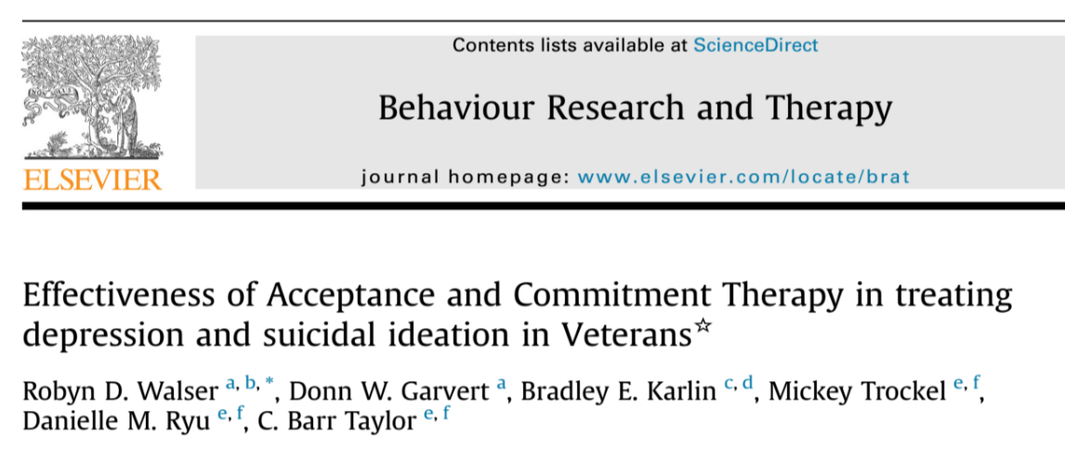
Lessons learned from the VA Training Program in ACT:
The Data
BDI-II results indicated a reduction in SI from baseline to final session
Veterans with and without SI showed reduction in depression symptoms
Experiential acceptance and mindfulness were important processes
Notes:
RESULTS RELATED TO SI:
BDI-II scores, and the suicide question
At baseline (session one)- 934 patients responded to BDI-II question assessing suicidal ideation
44.2% had no SI
50.5% had SI but no suicidal intent
4% indicated that would like to kill themselves
1.3% indicated they would do so if they had the chance
548 patients provided an answer to the SI question at three assessment points: baseline, midpoint (week 7), and final assessment
Number of patients reporting NO SI increased from 44.5% at baseline to 65% at follow up.
That’s a 20.5% reduction in SI from base-line to follow up, by treating Depression with ACT
Patients with and without SI had similar improvement with treatment
Both steadily improved in depression scores over time, suggesting that both groups responded well to ACT for Depression.
When adjusted for similar levels of acceptance and mindfulness, those with SI had a greater reduction in depression severity after ACT treatment.
For those with SI, achieve the greatest reduction in depression severity if they engage in ACT processes that result in experiential acceptance and mindfulness.
Consistent with past research suggesting that mindfulness is an important component of treating depression.
Experiential acceptance seems important- was associated with decreases in suicidal ideation, even after controlling for baseline depression severity.

Slide 4
Lessons Learned from the VA Training Program in ACT: Impressions of a Training Consultant
ACT can provide a useful and effective framework for working with suicide
Potential pitfalls I’ve seen
  Reluctance to do Creative Hopelessness with suicidal patients
  Seeking an ACT intervention to solve the problem/fix it
  Getting into convincing/ power struggle with client about staying alive
Importance of support for therapist- evocative for new ACT clinician
Safety planning
  More paperwork , or can it be a useful tool?
Notes:
ACT can provide a useful and effective framework for working with suicide
Potential pitfalls
Clinicians are often reluctant to do Creative Hopelessness with suicidal patients.
Looking for an ACT intervention to solve the problem/fix it.
Sometimes people are excited about ACT and can see how it is a useful framework, so they overrely on ACT technique to reduce their own discomfort.
Can be a problem if it is at the expense of really exploring suicide
3. Trying to convince clients not to kill themselves.
Might this dig patients deeper into convincing you that it IS a good idea?
Power struggle can emerge- a tension between patient’s autonomy and clinician’s desire/ethical obligation to try to keep the person alive.
Safety planning. Can be more paperwork -or!- can be a useful tool for increasing awareness and behavioral flexibility.
Examples of it being done both ways…

Slide 5
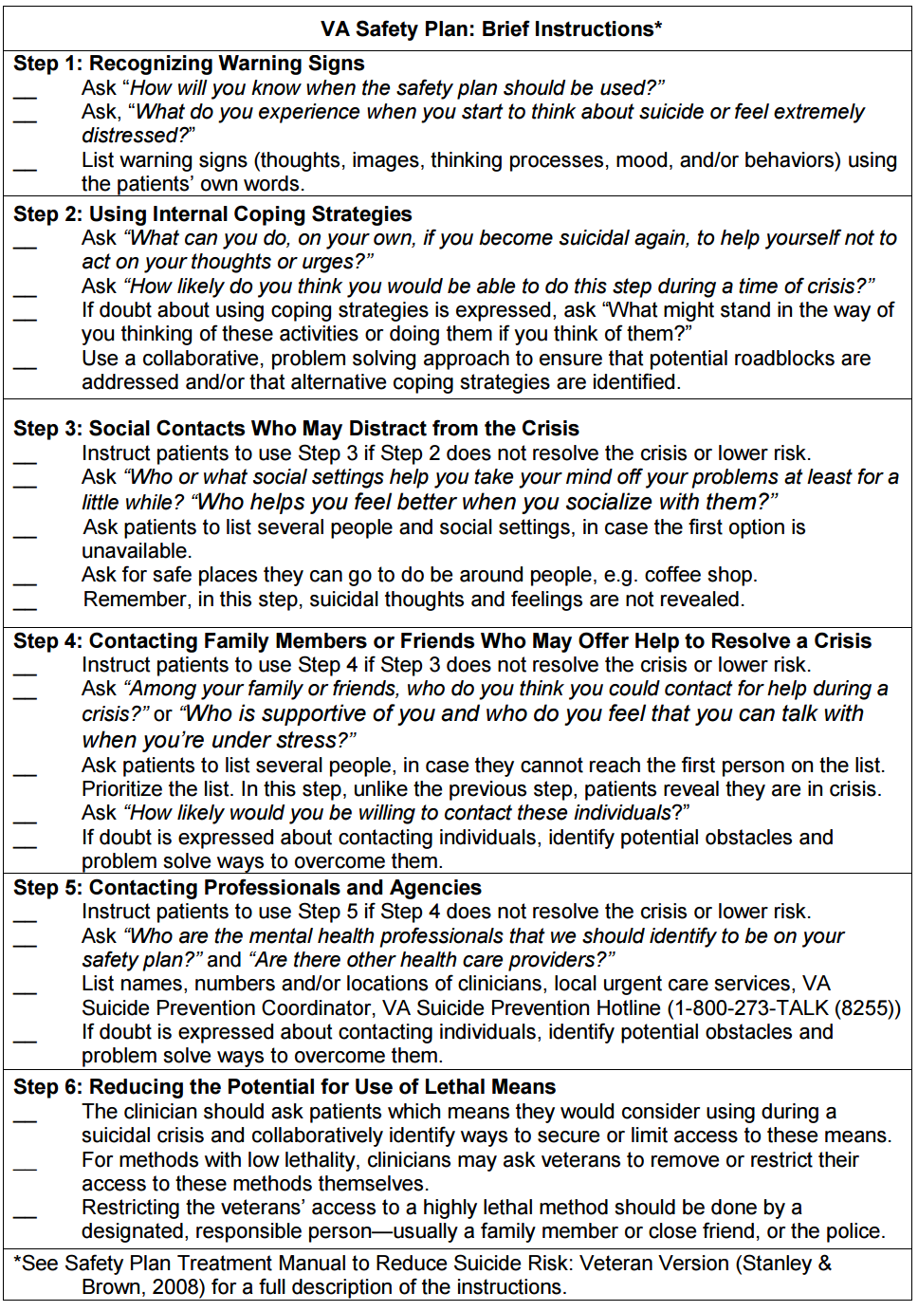
Notes:
Step 1: Recognize Warning Signs- can be useful for awareness.
Steps 2-5: Can be used to increase behavioral flexibility. Do something different next time!
Making life-enhancing choices
Can help to interrupt depressive and ruminative processes
Also, can encourage opening up to other people about inner experience- talking to a trusted person or clinician
My advice is to put some thought into this, help your client think this through in a useful way (can almost serve as a partial Functional Analysis if done well).
Make it a collaborative process with your client.
An ACT conceptualization can be helpful for guiding the clinician in this (for instance, values, awareness, behavioral framework)

Slide 6
Notes:
Step 1: Recognize Warning Signs- can be useful for awareness.
Steps 2-5: Can be used to increase behavioral flexibility. Do something different next time!
Making life-enhancing choices
Can help to interrupt depressive and ruminative processes
Also, can encourage opening up to other people about inner experience- talking to a trusted person or clinician
My advice is to put some thought into this, help your client think this through in a useful way (can almost serve as a partial Functional Analysis if done well).
Make it a collaborative process with your client.
An ACT conceptualization can be helpful for guiding the clinician in this (for instance, values, awareness, behavioral framework)

Slide 7
SAFETY PLAN
Step 1: Warning Signs
Step 2: Internal Coping Strategies
Step 3: Social Contacts Who May Provide a Distraction
Step 4: People Who Can Help Resolve the Crisis
Step 5: Contacting Professionals and Agencies
Step 6: Reducing the Potential Use for Lethal Means
Step 1: Awareness
Steps 2-5: Can be used to increase behavioral flexibility
Make it useful, can be similar to a functional analysis
Collaborative process
Notes:
Step 1: Recognize Warning Signs- can be useful for awareness.
Steps 2-5: Can be used to increase behavioral flexibility. Do something different next time!
Making life-enhancing choices
Can help to interrupt depressive and ruminative processes
Also, can encourage opening up to other people about inner experience- talking to a trusted person or clinician
My advice is to put some thought into this, help your client think this through in a useful way (can almost serve as a partial Functional Analysis if done well).
Make it a collaborative process with your client.
An ACT conceptualization can be helpful for guiding the clinician in this (for instance, values, awareness, behavioral framework)

Slide 8
A functional/contextual perspective
Conceptualizing/assessing suicide is an ongoing process, not a one-time event.
Understanding the context and function- critical to understanding the meaning of the behaviors
  Thinking about suicide – emotional control strategy/avoidance?
  The act of talking to a therapist about suicidal thoughts
  Actions taken toward self-harm
Think Behaviorally
  Inflexible repertoire of responding to emotional pain
Consider the context/function in terms of clinical response, as well.
  What is being reinforced by clinician?
  Do we (unintentionally) shame people who talk openly about suicide?
Notes:
Conceptualizing/assessing suicide is an ongoing process, not a one-time event.
Understanding the context and function- critical to understanding the meaning of the behavior
Thinking About Suicide is a behavior
Is the function related to emotional control/avoidance?
Does the person really want to die, or is he or she looing for a way to avoid or control emotional pain?
The act of talking to a therapist about suicidal thoughts is a behavior.
Examples:
Opening up about this scary problem could be a huge act of courage for one person.
For another, with a long history of frequent hospitalizations during times of emotional distress, it could be a maladaptive behavior that has been reinforced in the past
Actions taken toward self-harm are behaviors
Often people with SI have an inflexible repertoire of responding to their emotional pain.
Behavioral thinking about all of these behaviors. Can we use behavioral techniques to increase flexibility in how client responds to emotional pain?
Consider the context in terms of clinical response, as well.
Factors, such as…. Setting (group vs. individual, quick clinic appt vs. ongoing therapy relationship); Medical and mental health conditions that may be at play
What is being reinforced by clinician?
Do we (unintentionally) shame people who talk openly about suicide?
*A FAP approach can be really helpful here…. Think about clinically relevant behaviors you want to reinforce through your relationship with the client.

Slide 9
Possibly relevant* ACT processes and techniques**
*Depending on the context, of course!
**Caveat: Don’t rely too much on techniques, or use them solely to relieve your own discomfort. More important to connect with the human being who is suffering enough to consider suicide.

Slide 10
Possibly relevant* ACT processes and techniques**
Acceptance
  Creative Hopelessness
  Willingness to experience emotional pain
Defusion
  Normalizing and understanding thoughts of suicide
  Not taking thoughts too literally
  Urge surfing
Awareness
  Functional analysis to increase understanding of the context
  Mindfulness
  Perspective-taking/self as observer
Values and Committed Action
  Choose life-affirming actions
  Building a life worth living
Notes:
Acceptance
Creative Hopelessness – Titrated? (In ACT For Depression, Zettle advocates doing enough CH to increase psychological flexibility, without encouraging client to revert back to suicidality as a preferred problem-solving strategy)
Willingness to experience emotional pain.
Defusion
Normalizing thoughts of suicide.
Understanding the function of thoughts of suicide as a way to try to control/avoid/escape painful feelings. Can treat them as we would any other unhelpful thought in ACT.
Not taking suicide-related thoughts too literally.
* Also hopeless thoughts, self-critical thoughts, etc…..
Interrupt rumination via awareness
Urge Surfing and other skills for not acting on thoughts. Urges come and go…
* Accepting the thought ≠ engaging in the behavior
Awareness
Functional analysis to understand the context.
Mindfulness- vs. getting sucked into suicidal thinking without awareness
Perspective-taking/self as experiencer or observer (Self-as-Context)
Values and Committed Action
Help the client choose life-affirming actions
Building a life worth living.

Slide 11
A few words of wisdom for treating suicidal clients
Go there! Be courageous.
  Create a compassionate, non-shaming space to explore what’s happening.
  Be clear and direct about ethical/reporting issues related to potential self-harm, and from there, invite the client to talk openly.
Be aware of your own reactions/behavior patterns when addressing suicide.
Take care of yourself! This is very hard work that we do…
Notes:
Go there! Be courageous.
Create a compassionate, non-shaming space to explore what’s happening. Might be the first time a person has talked openly about suicide to anyone.
Be clear and direct about ethical/reporting issues related to potential self-harm. This will reduce concern about whether you’ll hospitalize involuntarily.
Be aware of your own reactions/behavior patterns when talking to clients about suicide.
Is talking about suicide ever uncomfortable for you? Do you ever avoid to protect yourself emotionally? Hold back from “digging deep” about suicide?
What kinds of thoughts are you fused with about suicide in the therapy room?
Do you tend to overreact to suicide talk?
For example…. Client mentions occasional fleeting thoughts of suicide, clinician might taking them too seriously (unintentionally increasing fusion)
Underreact? (I sometimes find myself doing this- I suspect it goes back to early DBT training with chronically suicidal clients and not wanting to reinforce the wrong thing.)
Do you fall in the trap of looking for a “quick fix” or solution (i.e. the perfect ACT metaphor, providing the person a reason to live, trying to convince/talk them out of it)?
Be aware of pressure you may feel to keep a person alive, and how that impacts your behavior as therapist.
Do your own responses to suicide talk influence your decision-making process, and how?
Take care of yourself! This is very hard work that we do…
It is scary, confusing, uncomfortable. We watch clients walk away, not knowing for sure what they will do (and having a client who does die from suicide is one of the hardest experiences for therapists)

Slide 12
Thank you!
  Robyn Walser and the VA Training Consultants in ACT.
    *Jaymee Dow & Jen Fabrizio
  My consultees from the training program, who have taught me so much about doing therapy.
  The veterans who let me “go there” with them.
  Sean Barnes and my fellow panelists.
My Contact Info:
  Debbie Sorensen, PhD.
  Denver V.A. Medical Center
  debbie.sorensen@gmail.com
  debra.sorensen@va.gov
  303-399-8020 ext. 5028

Slide 13
Discussion Questions
How far should you go into Creative Hopelessness with suicidal clients? Do you titrate Creative Hopelessness, or does that gloss over a key part of ACT therapy?
How about the funeral or tombstone exercises? Do you dare use them, or is the death aspect too provocative?
How can we best promote acceptance of suicide-related thoughts without inadvertently encouraging suicidal behavior?
Notes:
Lightening up the Creative Hopelessness talk, Person-in-a-hole metaphor, etc.
Titrated? (In ACT For Depression, Zettle advocates doing enough CH to increase psychological flexibility, without encouraging client to revert back to suicidality as a preferred problem-solving strategy)

Slide 14
Discussion Questions
What personal responses do you have to suicide talk in therapy, and how does that influence your decision-making process?
How do you balance ethical guidelines and pressure to keep clients alive with addressing suicide as a clinical issue?
In what other ways can ACT be helpful for addressing suicide?

